Slide 1
KTU CS463 Web Programming
S7 CSE Programme Elective
Module 4

Slide 2
Form processing and Business Logic
Uses Super global arrays which are associative arrays predefined by PHP that hold variables acquired from user input, the environment or the web server, and are accessible in any variable scope

Slide 4
$_GET and $_POST retrieve information sent to the server by HTTP get and post requests
for form handling, the PHP script is embedded in an XHTML document
uses the implicit arrays to form values, $_POST and $_GET
These arrays have keys that match the form element names and values that were input by the client
For example, if a form has a text box named phone and the form method is POST, the value of that element is available in the PHP script as follows:
$_POST["phone"]

Slide 5
The built-in $_GET function is used to collect values from a form sent with method="get"
Information sent from a form with the GET method is visible to everyone and has limits on the amount of information to send (max. 100 characters)

Slide 6
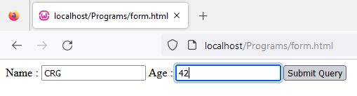
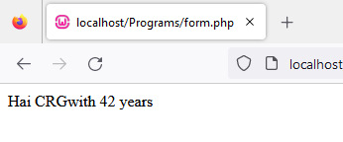
Form.php
Form.html
<html>
<body>
<?php
if(isset($_POST["submit"]))
{
if(($_POST["name"]!="")||($_POST["age"]!=""))
{
echo "Hai ".$_POST["name"];
echo "with ".$_POST["age"]." years";
}
else
{
echo "Invalid";
}
}
?>
<html>
<body>
<form method = "POST" action = "form.php">
Name : <input type="text" name = "name" >
Age : <input type = "text" name ="age" >
<input type="submit" name = "submit">
</form>
</body>
</html>

Slide 7
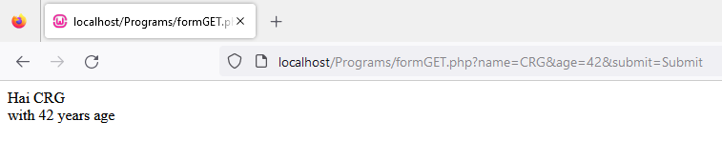
FormGet.php
<html>
<body>
<form method="GET" action ="formGET.php">
Name : <input type="text" name ="name" />
Age : <input type="text" name = "age" />
<input type = "submit" name = "submit" value = "Submit">
</form>
</body>
</html>
<?php
}
?>
<?php
if(isset($_GET['submit']))
{
if(($_GET["name"]!="")||($_GET["age"]!=""))
{
echo "Hai ".$_GET['name']."<br/>";
echo "with ".$_GET['age']." years age";
exit();
}
else
{
print "invalid";
}
}
else
{
?>

Slide 8
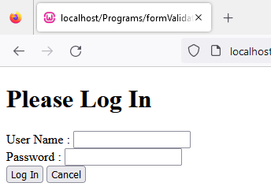
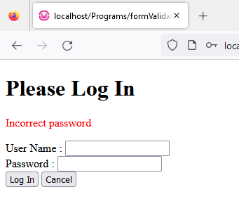

Form Validation – Login form

Slide 9
Form Validation – Login form
<?php
if(isset($_GET['cancel']))
{
header("Location:index.php");
}
$failure=false;
if(isset($_GET['who'])&& isset($_GET['pass']))
{
if(strlen($_GET['who'])<1 || strlen($_GET['pass'])<1)
{
$failure = "User name and password are required";
}
else
{
$check=$_GET['pass'];
$pwd="admin";
if($check == $pwd)
{
header("Location: welcome.php?name=".urlencode($_GET['who']));
return;
}
else
{
$failure="Incorrect password";
}
}
}
?>
<!DOCTYPE html>
<html lan="en">
<body>
<div>
<h1>Please Log In</h1>
<?php
if($failure !== false)
{
echo ('<p style="color: red;">'.htmlentities($failure)."</p>\n");
}
?>

Slide 10
Form Validation – Login form
<form method="GET">
<label>User Name : </label>
<input type="text" name="who" id="nam"><br>
<label>Password : </label>
<input type="password" name="pass" id="id_1723"><br>
<input type="submit" value="Log In">
<input type="submit" name="cancel" value="Cancel">
</form>
</div>
</body>
</html>

Slide 11
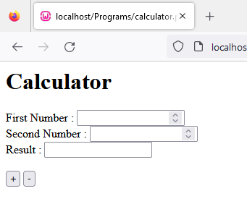
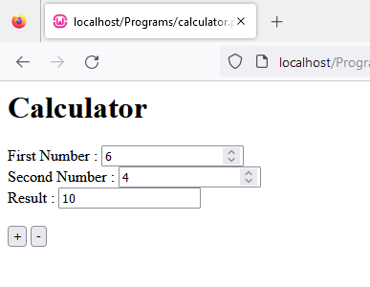
Simple calculator program

Slide 12
Simple Calculator
<html>
<body>
<h1>Calculator</h1>
<form action = "calculator.php" method="POST">
First Number : <input type="number" name="fnum" value="<?php echo $first;?>"><br>
Second Number : <input type="number" name="snum" value="<?php echo $second;?>"><br>
Result : <input readonly="readonly" name="result" value="<?php echo $result;?>">
<br>
<br>
<input type="submit" name="operator" value="+">
<input type="submit" name="operator" value="-">
</form>
</body>
</html>
<?php
$first='';
$second='';
$result='';
if(isset($_POST["operator"]))
{
$first=$_POST['fnum'];
$second=$_POST['snum'];
$op=$_POST['operator'];
$result='';
if(is_numeric($first)&&is_numeric($second))
{
switch($op)
{
case "+": $result=$first+$second;
break;
case "-": $result=$first-$second;
break;
}
}
}?>

Slide 13
Cookies and Session
A cookie is a small file that the server embeds on the user's computer to identify a user
Each time the same computer requests a page with a browser, it will send the cookie too
With PHP, you can both create and retrieve cookie values
provides a general approach to storing information about sessions on the browser system itself
The server is given this information when the browser makes subsequent requests for Web resources from the server
allows the server to present a customized interface to the client
also allow the server to connect requests from a particular client to previous requests, thereby connecting sequences of requests into a session

Slide 14
Cookies and Session
At the time it is created, a cookie is assigned a lifetime. When the time a cookie has existed reaches its associated lifetime, the cookie is deleted from the browser's host machine
a particular cookie is information that is exchanged exclusively between one specific browser and one specific server
A cookie is set in PHP with the setcookie function. This function takes one or more parameters.
setcookie(name, value, expire, path)

Slide 15
Cookies and Session
At the time it is created, a cookie is assigned a lifetime. When the time a cookie has existed reaches its associated lifetime, the cookie is deleted from the browser's host machine
a particular cookie is information that is exchanged exclusively between one specific browser and one specific server
A cookie is set in PHP with the setcookie function. This function takes one or more parameters.
setcookie(name, value, expire, path)
Mandatory, string
New value, string
Time in seconds, integer, default 0 (end of current session)

Slide 16
Cookies and Session
setcookie(“valid", "true", time() + 86400);
creates a cookie named "valid" whose value is "true" and whose lifetime is one day (86,400 is the number of seconds in a day)

Slide 17
Cookies and Session
Available in entire website
To check if cookie is set
Global variable to retrieve cookie value

Slide 18
Cookies and Session
setcookie(“valid", "true", time() -3600);
To delete a cookie, use setcookie() function with an expiration date in the past:
cookie values are treated much like form values
All cookies that arrive with a request are placed in the implicit $_COOKIES array, which has the cookie names as keys and the cookie values as values
most browsers have a limit on the number of cookies that will be accepted from a particular server site

Slide 19
Cookies and Session
Rather than using one or more cookies, a single session array can be used to store information about the previous requests of a client during a session
session arrays often store a unique session ID for a session

Slide 20
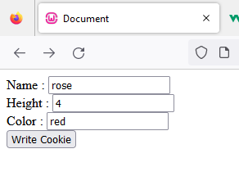

Create cookie using form data

Slide 21
Create cookie using form data
<?php
if(isset($_POST["submit"]))
{
setcookie("name",$_POST["name"],time()+(86400*5));
setcookie("height",$_POST["height"],time()+(86400*5));
setcookie("color",$_POST["color"],time()+(86400*5));
$name=$_COOKIE["name"];
$height=$_COOKIE["height"];
$color=$_COOKIE["color"];
echo "Cookie set successfully";
echo "<p>Name : $name</p> Height : $height, Color: $color";
}
else
{
?>
<!DOCTYPE html>
<html>
<head>
<title>Document</title>
</head>
<body>
<form method="post" action="writecookie.php">
<label>Name : </label>
<input type="text" name="name"><br>
<label>Height : </label>
<input type="text" name="height"><br>
<label>Color : </label>
<input type="text" name="color"><br>
<input type="submit" name="submit" value="Write Cookie"><br>
</form>
</body>
</html>
<?php
}
?>

Slide 22
Session
on the internet the web server does not know who you are or what you do, because the HTTP address doesn't maintain state
Session variables solve this problem by storing user information to be used across multiple pages (e.g. username ,pwd etc)
By default, session variables last until the user closes the browser
Session variables hold information about one single user, and are available to all pages in one application
differ from cookies is that they can be stored on the server, whereas cookies are stored on the client

Slide 23
Session
session ID is an internal value that identifies a session
Session IDs need not be known or handled in any way by PHP scripts
session_start function causes a session ID to be created and recorded
On subsequent calls to session_start in the same session, the function retrieves the $_SESSION array, which stores any session variables and their values that were registered in previously executed scripts in this session
A session is started with the session_start() function.
Session variables are set with the PHP global variable: $_SESSION

Slide 24
Session

Slide 25
Session – destroy a session
session_unset() and session_destroy() removes all global session variables and destroy the session

Slide 26
MySQL Integration-Connecting to MySQL with PHP
The most popular ways to connect a PHP script to MySQL are MySQli and PDO
MySQL is an open-source relational database management system (RDBMS) used with PHP
data in a MySQL database are stored in tables that consist of columns and rows
MySQL is a database system that runs on a server ideal for both small and large applications which is very fast, reliable, and easy-to-use
uses standard SQL and compiles on a number of platforms
PHP 5 and later can work with a MySQL database using:
MySQLiextension (the ‘i’ is abbreviation for improved)
PDO (PHP Data Objects)

Slide 27
MySQL Integration-Connecting to MySQL with PHP
Connection to MySQL using MySQLi
PHP provides mysql_connect() function to open a database connection
To disconnect from the MySQL database use mysql_close().
There is also a procedural approach of MySQLito establish a connection to MySQL database from a PHP script

Slide 28
MySQL Integration-Connecting to MySQL with PHP
The basic syntax for a connection to MySQL is as follows:
$mysqli= mysqli_connect("hostname", "username", "password", "database");
Eg.
$mysqli= mysqli_connect("localhost", “root", “ ", "test");

Slide 29
MySQL Integration-Connecting to MySQL with PHP

Slide 30
MySQL Integration-Connecting to MySQL with PHP
Just like exit()

Slide 31
Registration form

Slide 32
Registration form

Slide 33
Registration form

Slide 34
Registration form

Slide 35
Select Data From a MySQL Database
Select Data With MySQLi can also be done in two ways
►MySQLi Object-oriented
►MySQLi Procedural

Slide 38
Update database

Slide 39
Update database

Slide 40
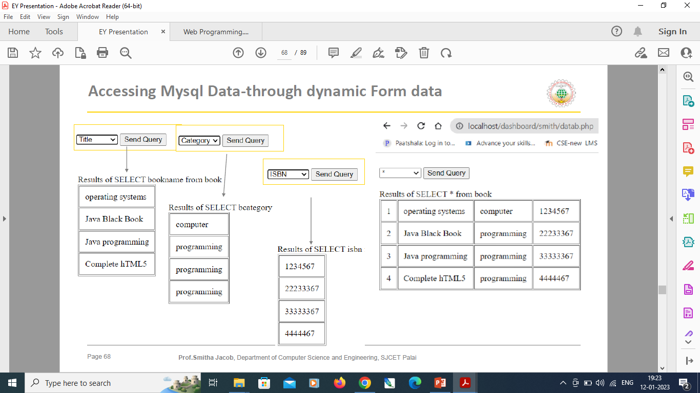
Accessing MySQL Data dynamically using form data

Slide 41
Accessing MySQL Data dynamically using form data

Slide 43
Dynamic Content
web content that changes based on the behavior, preferences, and interests of the user
It refers to websites as well as e-mail content and is generated at the moment a user requests a page
classical example is the HTML content of a landing page or of an e-mail that changes to display information that is relevant for the viewer based on location or previous interactions with the website
PHP code runs between the requested page and the web server, adding to and changing the basic HTML output

Slide 44
Dynamic Content
There are three main types of dynamic information on the Web:
Dynamic data—Variables within a Web page are generated
Dynamic Web pages—An entire Web page is generated
Dynamic content—Portions of a Web page are generated
All dynamic content has one thing in common: It comes from a data source outside the originating page

